Slide 1
Spatial accessibility to the COVID-19 testing sites and the driven factors behind in NYC
Mid-point Presentation
Kelly Anran Zheng

Slide 2

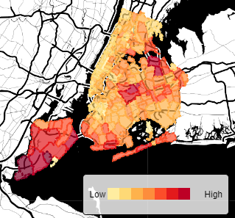

Background
Problems with existing research:
Lack of research on a micro-level region
most studies only considered one travel mode rather than mulitimodal
very few studies explored the driven factors of spatial accessibility to medical resources
Notes:
Testing site is one important public facility in the prevention of COVID-19.
Literature review. Although there is lots of studies on the measurement of spatial accessibility to health care services
Many research focuses on the county level of accessibility measurement of a whole state. However, investigating a micro-level region will be more meaningful because in reality, people tend to travel across tracts rather than counties to access the COVID-19 medical resources timely.
, most studies only considered one travel mode, especially driving, in the measurement of accessibility. But when accounting for a city, accessibility by different transit modes (personal vehicles, walking and public transit) should be analyzed and compared since multimodal network is a fundamental component of a city
…

Slide 3
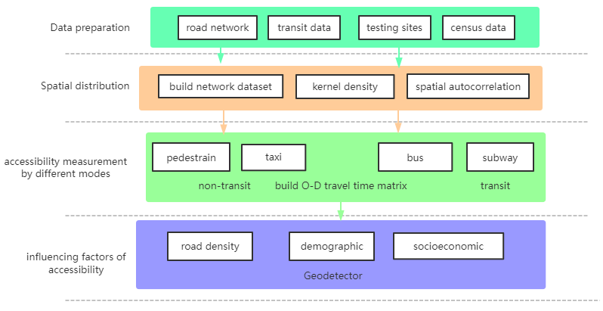
Methods
√
√
√
Notes:
Based on these problems… four most common travel patterns in NYC, including walking, driving, subway and bus, are compared based on the O-D travel time matrix of ArcGIS Network Analyst

Slide 4
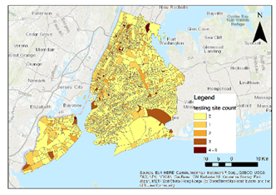
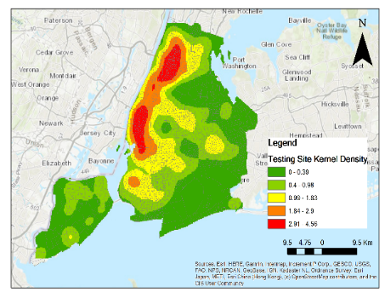
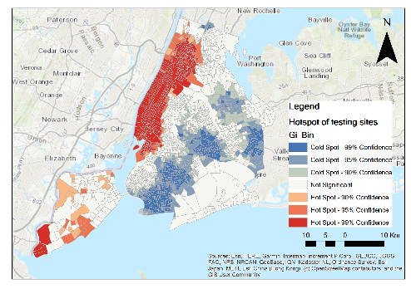
Spatial distribution
(a) (b) (c)
the spatial distribution of COVID-19 testing sites in NYC: (a) count of testing sites contained in each tract. (b) kernel density estimation of testing sites. (c) hotspots of testing sites
Notes:
Spatial autocorrelation and kernel density estimation methods
the testing sites are spatially clustered in NYC.

Slide 5
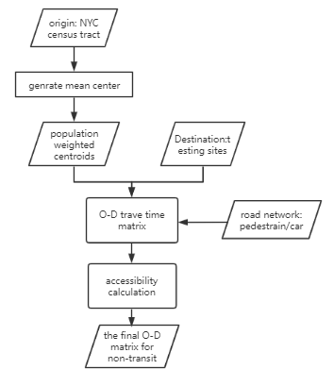
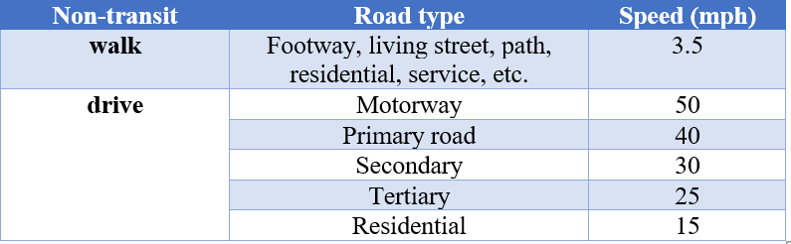
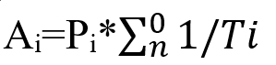
Accessibility: non-transit
Ai=Pi*∑_n^0▒〖1/Ti〗
Where Ai is the accessibility of census tract i, Pi is the total population number of census tract i, n is number of testing sites that people can access within 15 minutes and Ti is the time people spend getting to each testing site.
Notes:
Walking and driving are categorized into non-transit mode. Calcualte the census tract i’s accessibility. Considering that people typically walk and drive on different types of roads, this study extract common types of roads for pedestrians and drivers as table 1 shows.

Slide 6
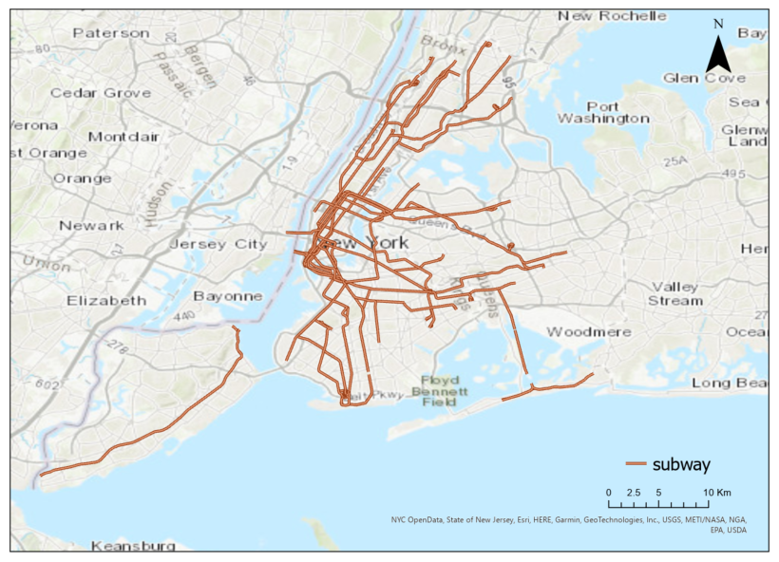
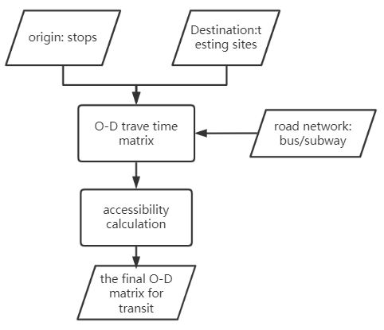
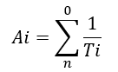
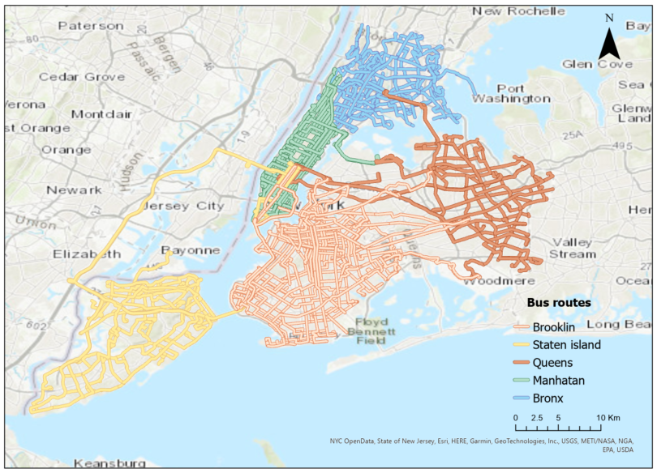
Accessibility: transit
Where n stands for the count of testing sites that can be reached within 15 minutes of taking the subway or buses, while Ti is the time people spend getting to each testing site starting from stop i.
Notes:
To evaluate how transit improves the accessibility, subways and buses, two dominant transit systems, are chosen and their accessibilities are calculated differently from the non-transit modes, since transit routes and schedules are fixable with given stops that travelers should take., the transit road network for subway and bus are built based on the GTFS data. The transit accessibility of each stop is calculated as the following equation:
The speeds of taking the subway and bus are set to 28km/h and 13km/h respectively. To build a comprehensive transit road network system, pedestrian road network is combined with the subway or bus route system, since when getting off the nearest stops to the testing sites, people still need to walk for a while to reach their final destination, the testing sites.

Slide 7
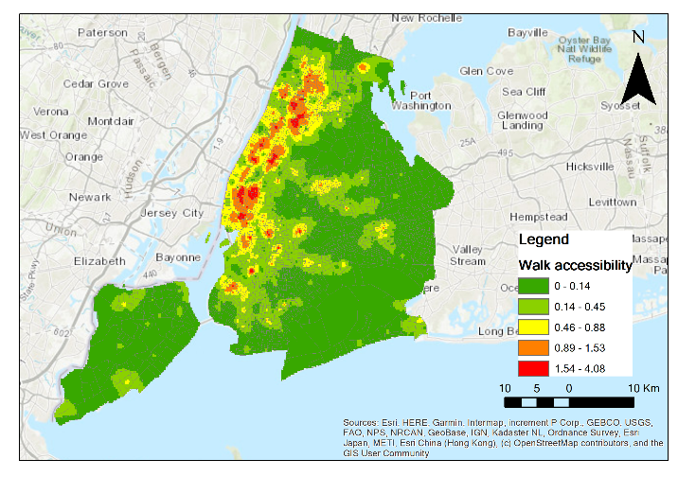
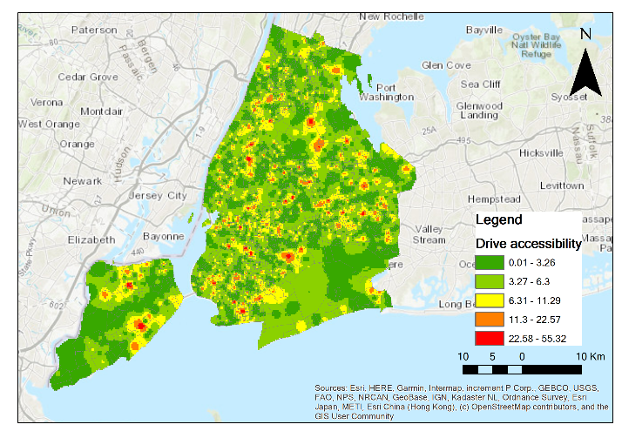
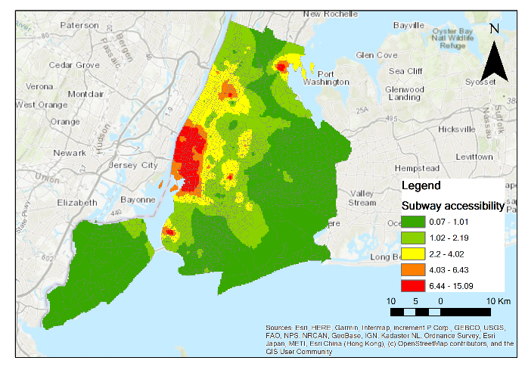
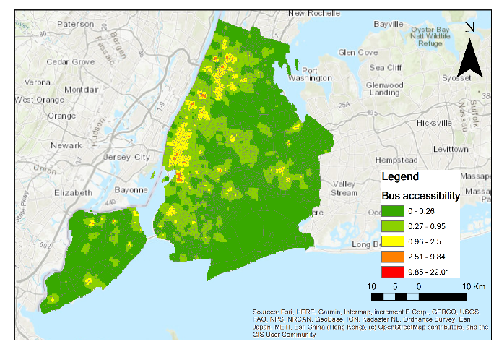
a.
b.
Non-transit
Walk
Drive
Transit
c. Subway
d. Bus
c.
d.
Notes:
. Walk accessibility indicates a tightly clustering distribution pattern, which is highest in Manhattan and decreases gradually to the edge. In contrast, the distribution of drive accessibility is random, with a few highest regions in Manhattan and Brooklyn, Queens and Staten Island. The accessibility enhances significantly from walking to driving, since ideally with driving, people can access to more testing sites within a shorter time. However, in reality the driving accessibility will be less than this study shows, considering the traffic congestion and parking issues. Transit accessibility is highest in Manhattan and decay gradually to the boundary of NYC. Most regions are more accessible to subways than bus, since typically subways take shorter time to wait and hardly encounter traffic jam, despite that there are much more bus stations than subways in NYC.

Slide 8
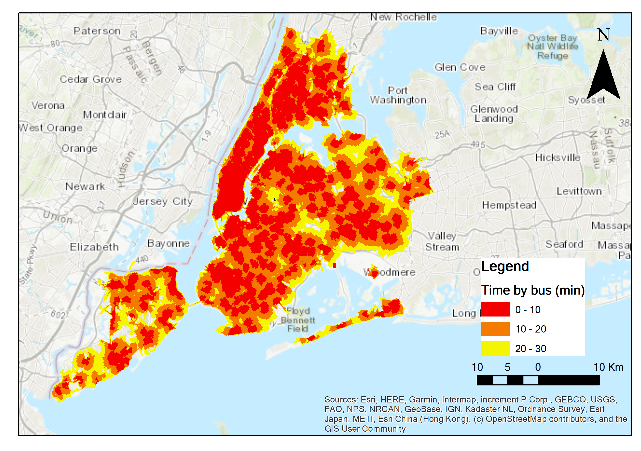
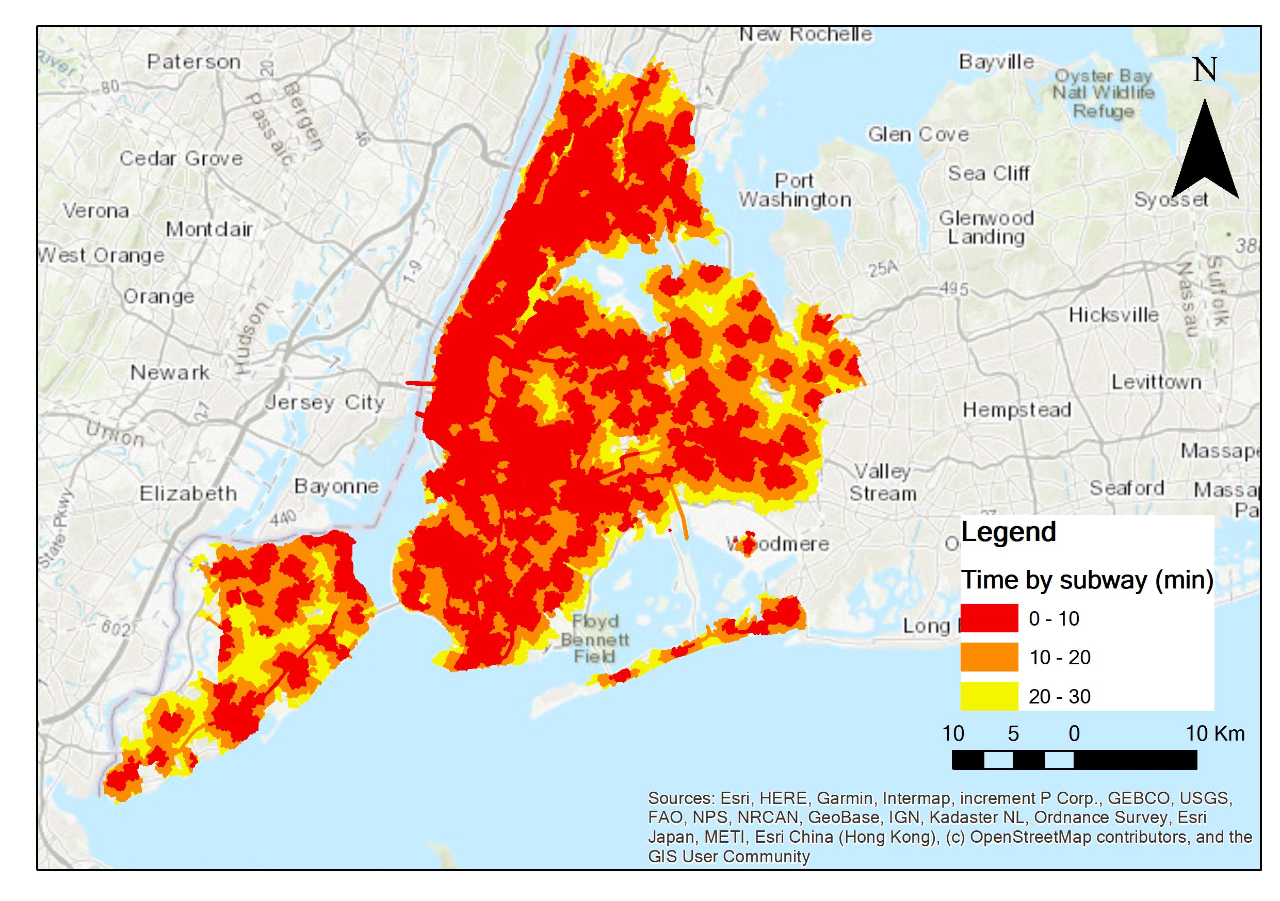
Service Area
Notes:
By subways or buses, within half an hour people can access almost all the testing sites in NYC. High transit acessibility

Slide 9
Next steps: Influencing factors detection
Calculate and compare the influencing factors of spatial accessibilities by different modes with Geodetector, GWR or other methods (choose the one with the highest accuracy)

Slide 10
Thanks! Q&A

